Slide 1
Project Minigreen
Benjamin waters, Stephen Lawson, AAron Hebert

Slide 2
Proposal
What we are about?
Finding problems before they become problems.
Making purchasing decisions easier.
What is the problem?
Inventory management woes.
What our program offers
Ability to view items, history, and possible future trends
How it will offer its services
Feed in your inventory history and look up results
Who it will appeal to
Small business owners
Uncertain/New business owners

Slide 3
Technical Details
What program will be used to develop it?
Python language
Django framework
Mongodb database
Will it require external resources?
No external resources necessary
Inputs csv/Excel files
Outputs a csv file as necessary

Slide 4
Current Limitations
No access to a real-time inventory system
Must rely on manual inputs/outputs.
As such, prices are static
Sudden trends (< 1 day) are unlikely to be caught quickly.
Alerts are only as useful as an observant employee
Accuracy depends on manual input of data
Easy to forget an update, work on poor information.

Slide 5
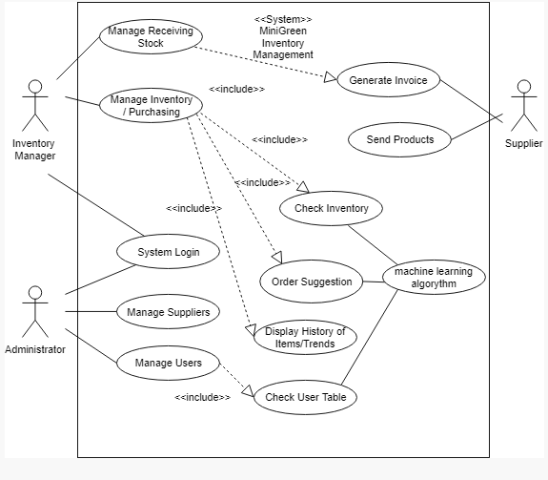
Use Case
Early vision of the plan
Main actors are the typical user and the administrator
Administrator
Sets user access
Normal user
Manages the inventory
Supplier
Would get exported data later

Slide 6
Gantt Chart
Developing the Gantt chart has been difficult
Scheduling times
Unknown deadlines
Dividing tasks
It took longer than expected
Studying AI Machine Learning may take the longest
None of us have done it before
Unsure of how long learning process could take
Could effect end date of task
Very satisfied with current schedule

Slide 7
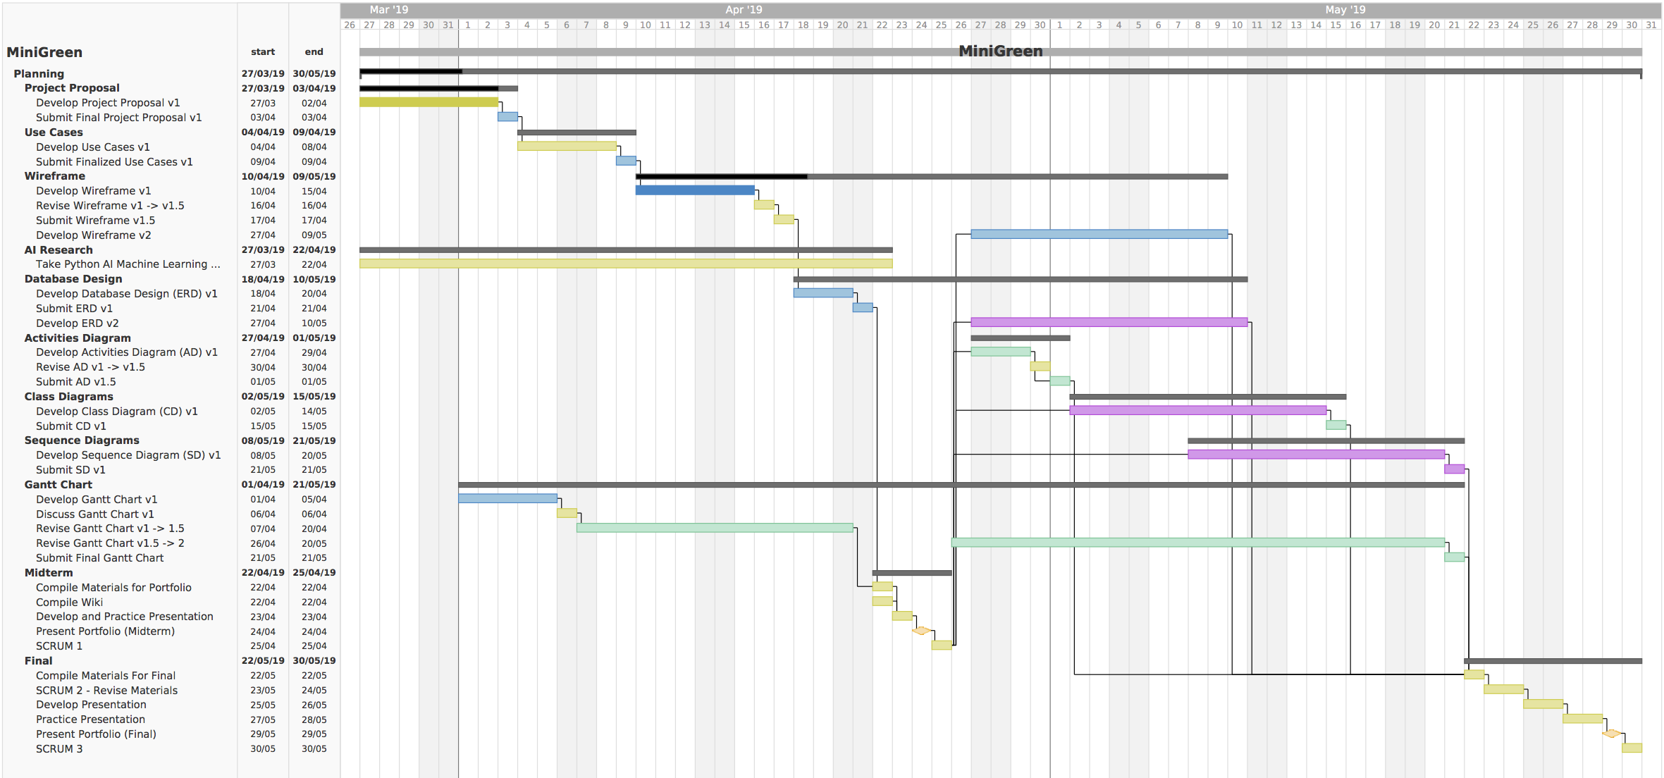

Slide 8
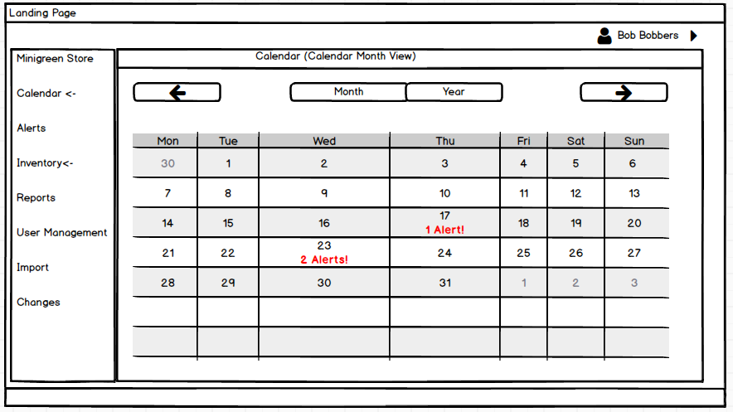
Wireframe Highlights
The side bar is to grab attention
Provides easy navigation
The Calendar
Highlights priority items
Possible to navigate to past and future events easily

Slide 9
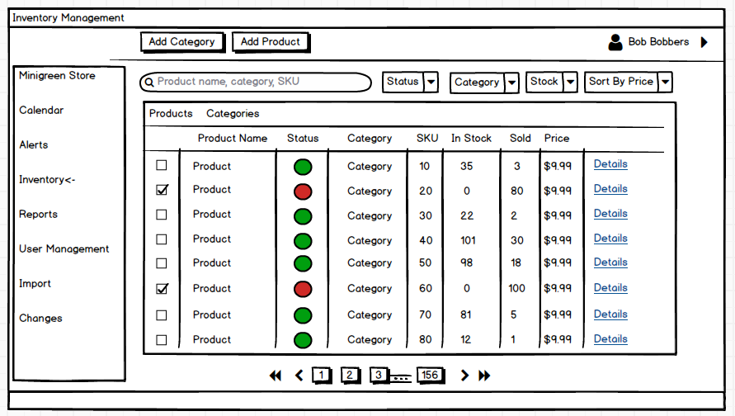
Wireframe Highlights
Inventory Page
Multiple ways to categorize
Colors grab attention
Easy access to item details
Adding and modification
Possible to navigate whole inventory

Slide 10
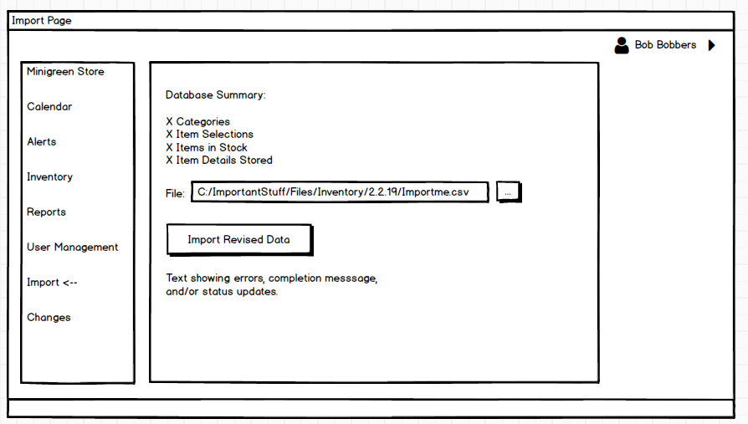
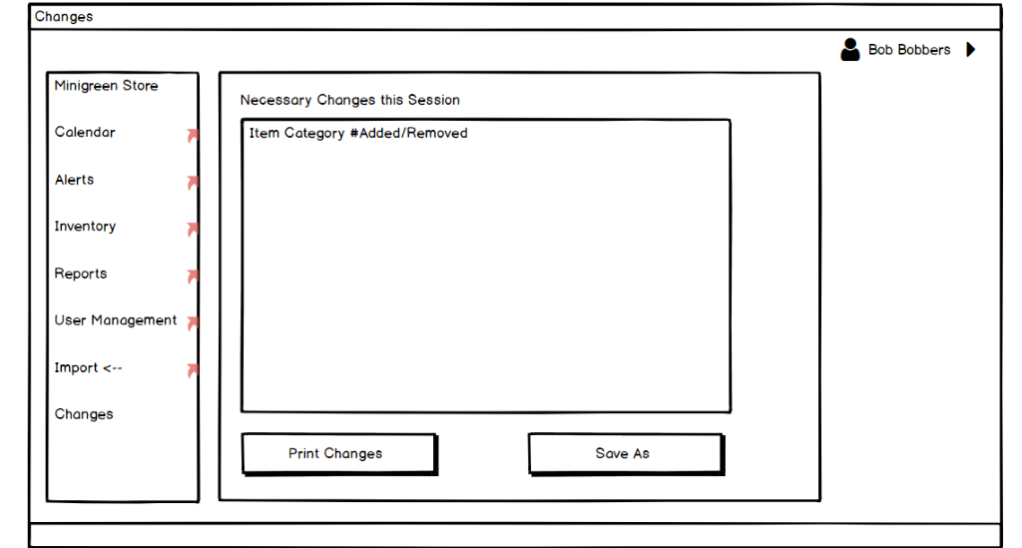
Wireframe Highlights
Importing Page
Essential component of program
Needs to easily add data
Show errors
Show conflicts
Export Page
Necessary to show needed changes
Details fed elsewhere

Slide 11
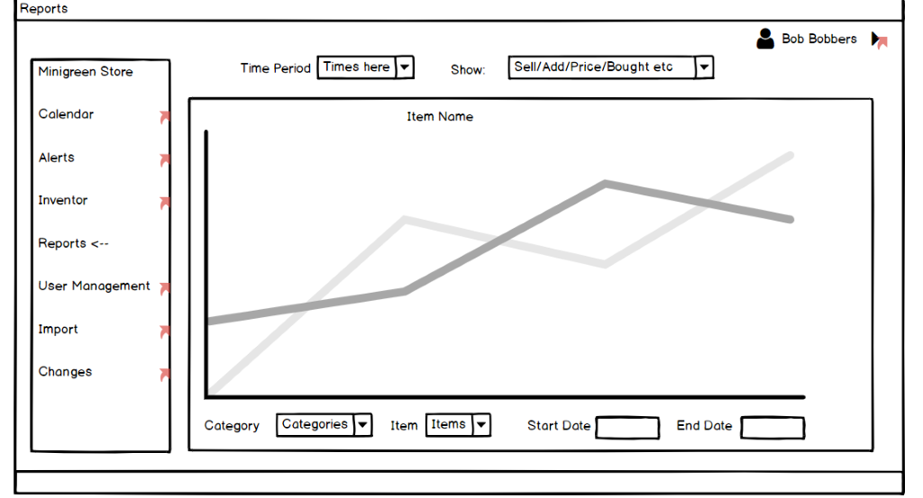
Wireframe Highlights
Report Page
Easiest way to show trends
Any item selectable
Core of the program
Visual representation of trends
Possibly add product comparison

Slide 12
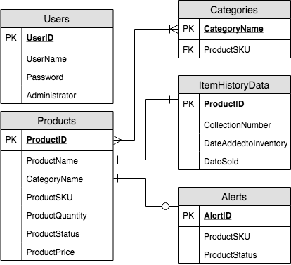
Entity Relationship Diagram
How is information stored?
Users have their own table
Category table for convenience
Products table each product
Items table
Individual items in each product
Much larger than others
Will hold crucial data for analysis

Slide 13
ERD
Why each piece of information is relevant?
You need user to log in
You need ItemHistoryData to keep track of history
You need Products to show lists of products
Categories helps in organization
Alerts contains the most urgent matters

Slide 14
ERD
How each table might interact with others?
Products is most connected
Users is isolated to logins
Only accessed at log and admin access
Others relate to search and prediction

Slide 15
Project Downsides
What might we not be able to address?
Need to find an efficient way to compare existing inventory with new inputs.
Boils down to efficient search methods.
What are the limitations we face?
The predictive software is only as accurate as your history.
What are some early problems?
Might face difficulties in working with a new framework
What are possible solutions to the problems?
Research, research, research.

Slide 16
In conclusion..
What we're hoping for from a finished product
An easy way to look through your inventory.
A simple graph of any given product, past and future.
A way to easily see possible issues in the future.

